Slide 1
A Brief History of the Creation of a Time Traveling Database
Chris Cumming

Slide 2


Who am I? (i.e. Shameless Self Promotion)
Saturday Morning Productions - Consultant
http://nftb.saturdaymp.com
chris.cumming@satudaymp.com
Edmonton .NET Users Group – Program Director
http://edmug.net

Slide 3
The Problem
Create application to adjudicate claims
Claims can be submitted months or even years later
Bunch of other normal business requirements

Slide 4


What Data Needs History?
Customers, Addresses, Relationships,
Companies, Service Providers, Bargaining Agreements,
Coverage Plans, Member Options, Lines of Coverage,
Eligibility, Fee Guides (Dental, Extended Health, etc.),
Fee Codes, Diagnosis Codes, Claim Evidence,
Rule Arguments, Coordination of Benefits
Notes:
Use effective dates on a couple tables. Nope.

Slide 5
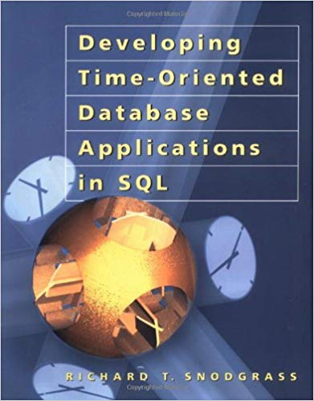
Found the Mystic Tome
Developing Time-Oriented Database
Applications in SQL
Richard T. Snodgrass
PDF Version:
https://www2.cs.arizona.edu/people/rts/tdbbook.pdf

Slide 6
History Database Requirements
Fast queries for claim adjudication
Allow gaps
Allow future dating
Day level precision
Work with existing DB (i.e. SQL Server) and Reporting tools

Slide 7
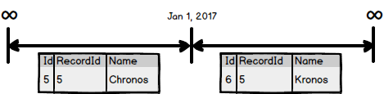
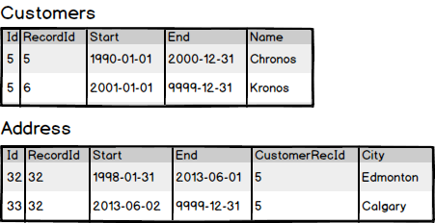
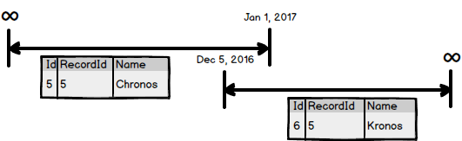
Core Design Rules
Timelines, records, and segments Foreign key integrity
Segments can’t overlap

Slide 8
Creating Temporal Tables
Table has Id, RecordId, StartDate, and EndDate fields.
Id is unique, not null, primary key, and auto incremented.
RecordId is shared across segments.
CREATE TABLE Customers
(
Id INT NOT NULL IDENTITY PRIMARY KEY,
RecordId INT NULL,
StartDate DATE NOT NULL,
EndDate DATE NOT NULL,
Name VARCHAR(100)
)
GO

Slide 9
Overlapping Segments Trigger
Use tool to create triggers for all temporal tables
CREATE TRIGGER TR_<Table>_OverlappingSegments ON <Table> FOR UPDATE, INSERT AS
IF EXISTS(
SELECT *
FROM <Table> t
INNER JOIN inserted i On i.RecordId = t.RecordId
AND t.Id <> i.Id
AND t.StartDate <= i.EndDate
AND t.EndDate >= i.StartDate
)
BEGIN
RAISERROR ('Tried to insert overlapping segments in <Table> table.', 16, 1);
ROLLBACK;
END
GO
Notes:
Truth be told this was handled in the software.

Slide 10
Foreign Key Triggers
Two triggers
Delete trigger for parent
Insert/update trigger for child
Use application to create triggers

Slide 11
Delete Trigger
CREATE TRIGGER TR_Customers_Addresses_ForeignKey_D ON Customers FOR DELETE AS
IF NOT EXISTS(
SELECT *
FROM Customers
Where RecordId IN (
SELECT CustomerRecId
FROM Addresses
INNER JOIN deleted On deleted.RecordId = CustomerRecId
)
)
BEGIN
RAISERROR ('Tried to deleted Customers record that is referenced by Addresses forgien key.', 16, 1);
ROLLBACK;
END

Slide 12
Insert/Update Trigger
CREATE TRIGGER TR_Addresses_Customers_ForeignKey_IU ON Addresses FOR INSERT, UPDATE AS
IF NOT EXISTS(
SELECT *
FROM Customers
Where RecordId IN (
SELECT CustomerRecId
FROM inserted
)
)
BEGIN
RAISERROR ('Tried to insert/update Addresses record that had a invalid forgien key to the Customers table.', 16, 1);
ROLLBACK;
END

Slide 13
Writing Queries
Query by RecordId and Query Date
Select * From Customers
Where RecordId = #
And StartDate <= ‘2000-03-15’
And EndDate >= ‘2000-03-15’
Join by RecordId’s, not by IDs
Select * From Customers c
Inner Join Addresses a On a.CustomerRecId = c.RecordId
And c.StartDate <= ‘2000-03-15’
And c.EndDate >= ‘2000-03-15’
And a.StartDate <= ‘2000-03-15’
And a.EndDate >= ‘2000-03-15’

Slide 14
Next Steps
Example on GitHub:
https://github.com/saturdaymp-examples/a-brief-history-of-the-creation-of-a-time-traveling-database
Other Items to Consider:
Not all data need temporality (i.e. financial tables).
Joining to non-temporal tables.
Fields that shouldn’t change (i.e. birthdate).
Effective vs Entered Temporality.

